Slide 1


Can Machine Learning predict the price of a used car based on its features?
By Luke Hales

Slide 2
Why should anyone care?
In the modern day, cars are a necessity to be able to travel anywhere. This is especially true in the US, as the country is designed around driving by car with very few options to travel long distance by public transport.
[Another point here]
Finding out what factors keep the price of a used car cheap would be very helpful for the average American, more so when considering the financial state the average US citizen finds themselves in.

Slide 3

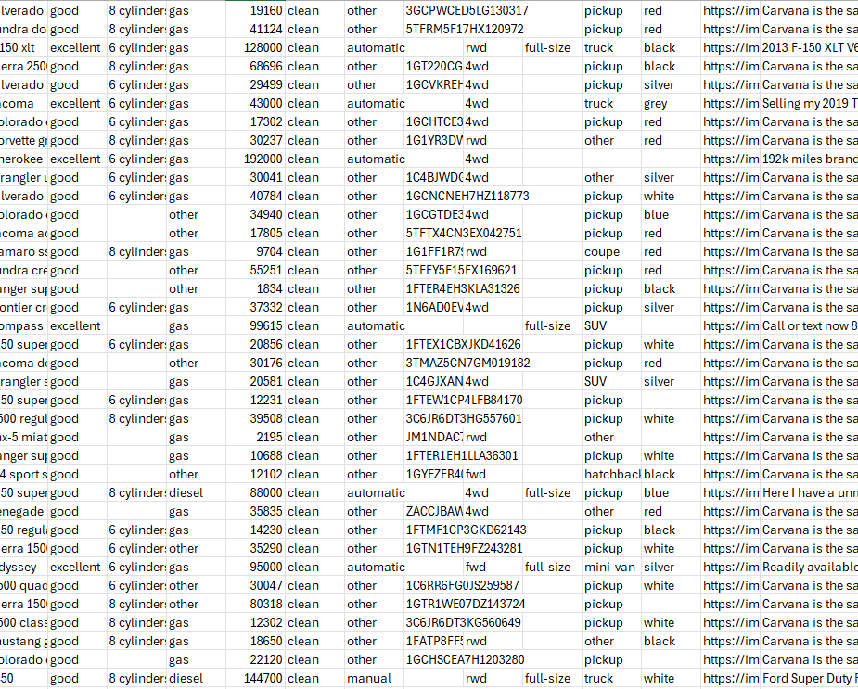
The Dataset
The dataset used is taken from Kaggle (https://www.kaggle.com/datasets/austinreese/craigslist-carstrucks-data)
It boasts 426880 unique entries. Despite this impressive number, the data must be cleaned as there are rows with missing data.
The columns of this dataset include Region, Region_URL, Price, Year, Manufacturer, Model, Condition, Cylinders, Fuel, Odometer, Title_Status, Transmission, VIN, Drive, Size, Type, Paint_Color, Image_URL Description, County, State, Lat, Long, Posting_Date

Slide 4
The Dataset - Continued
Obviously, not all these columns will be relevant factors to the price of the car. Columns such as URL would not have any effect on the price of the car.
As mentioned before, the data will need to be cleaned before it can become usable. Each row will need to have all the required factors for it to be a usable entry. Failing to achieve this may introduce a skew in the data as the model will not be able to learn properly.

Slide 5
Type of Machine Learning
There are two types of machine learning techniques that could be implemented: Regression and Classification.
Using Regression means that the model would attempt to predict the exact price of the car, whereas using Classification would attempt to place the price of the car in a discrete price range.
It would be ideal to use both ML techniques, as we could get both understand the factors that places the car in a specific price range, as well as have a prediction of how much a car would cost.
Classification would be a substantially more accurate than Regression.

Slide 6
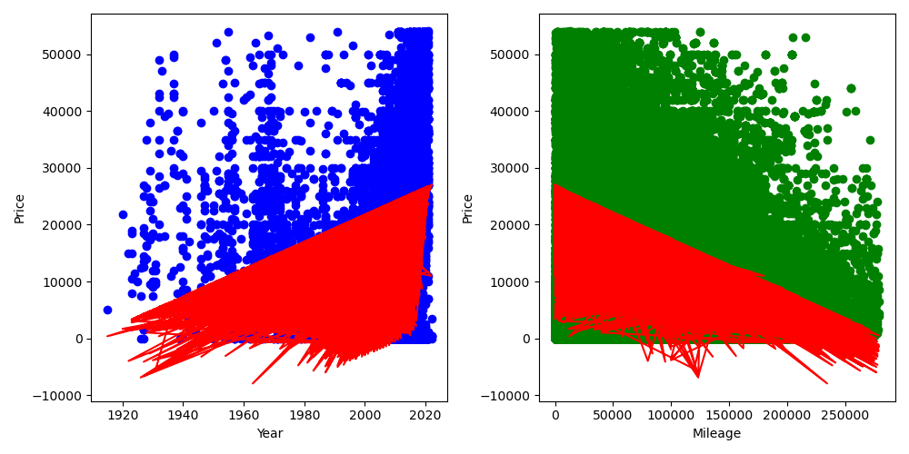
Model – Phase 1
These graphs show the initial linear regression model. This model only contains two independent values: the year of the car make and the mileage it has completed.
This model is clearly very inaccurate as it predicts negative prices for car, which of course cannot happen.
The R² value of this model on testing data is ~0.25 which shows its obvious inaccuracies. The intercept is -455290 and the coefficients are 2.38524738e+02, -8.88996801e-02.

Slide 7
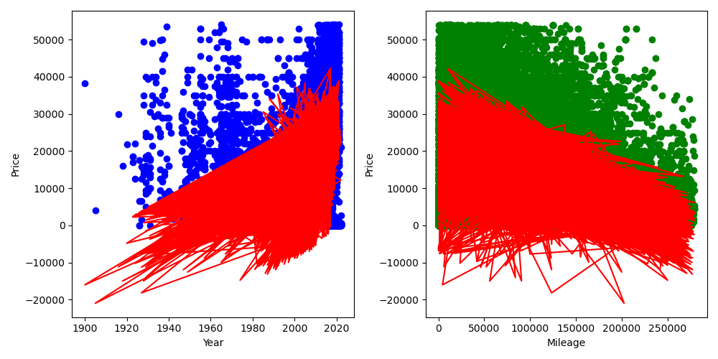
Model – Phase 1.5
This model now incorporates the number of cylinders a car has, to see if that influences price.
It seems more inaccurate on the surface, due to it dipping down further into the negatives.
The model actually has a higher R² than the previous model at ~0.37. The intercept is -619167 and the coefficients are 3.11829539e+02 -8.89849309e-02 2.77740195e+03

